Slide 1
Image Processing
Fourier Transform

Slide 2
Fourier Transform
Linear Algebra
Eigenvalues
Phase, Amplitude
FFT
The discrete Fourier transform

Slide 3
Fourier transform
Why?
alternative description
efficient calculation
less sensitive for
disturbances
More efficient, easier:
convolution
correlation
filtering
differentiating
shifting
compression

Slide 4
Linear Digital Filters
input
output
digital filter
How to design filters
What are the properties of filter
Linear Algebra
Fast convolution
Frequency domain representation

Slide 5
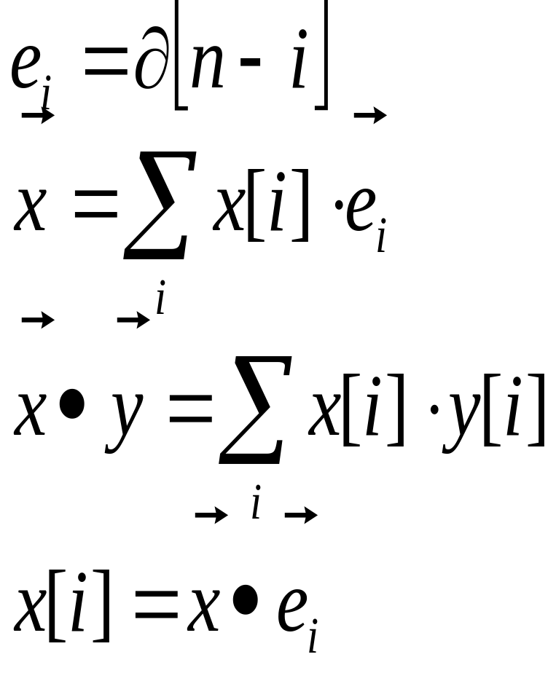
Linear Algebra 1D
base vector
signal representation
inner-product
elements of vector

Slide 6
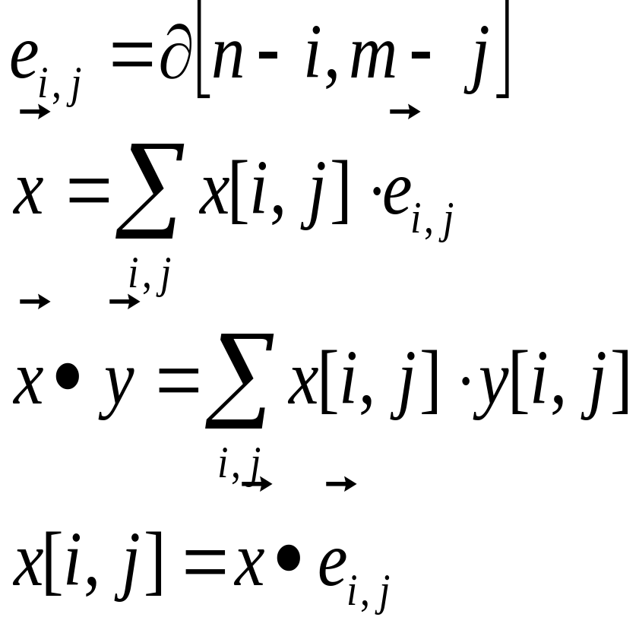
Linear Algebra 2D
base vector
signal representation
inner-product
elements of vector

Slide 7
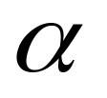
What is an image?
An image is a vector in the image-space
Cosine-rule = template matching

Slide 8
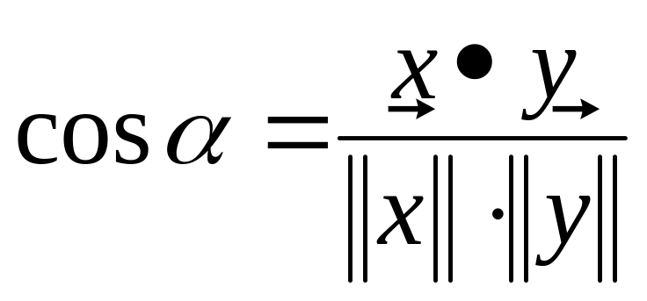
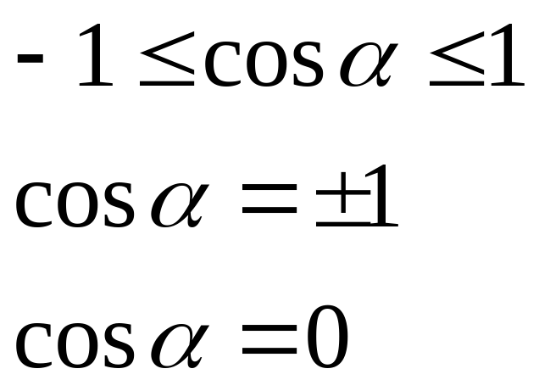
Template matching
bounded
linear dependent
orthogonal
equivalent
unequal

Slide 9
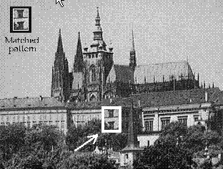
Template Matching
template
shift
cosine
match
image

Slide 10
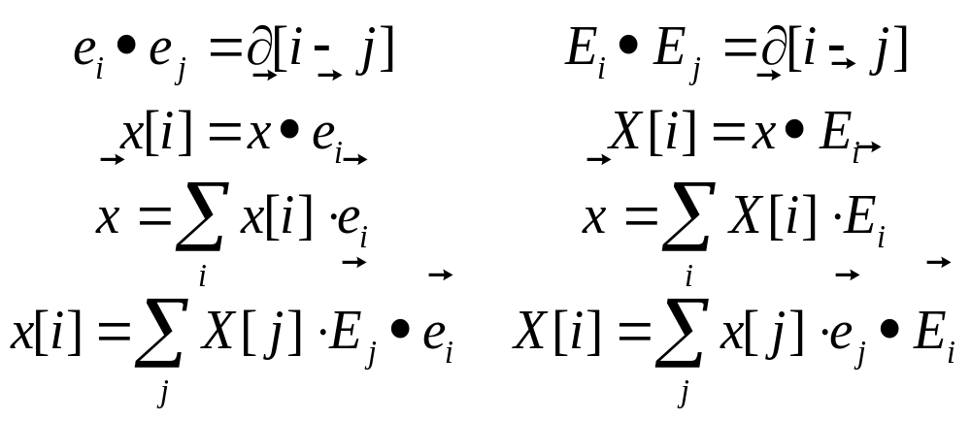
Base Transformation
Select a suitable orthonormal base

Slide 11
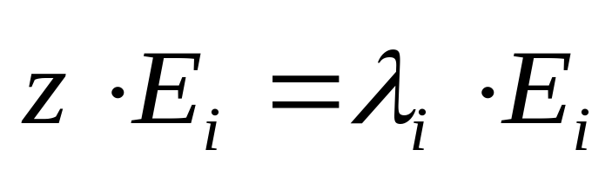
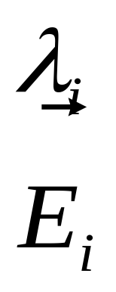
Eigenvalues and -vectors
Assume the matrix z which translates a signal
Eigenvalue
Eigenvector

Slide 12
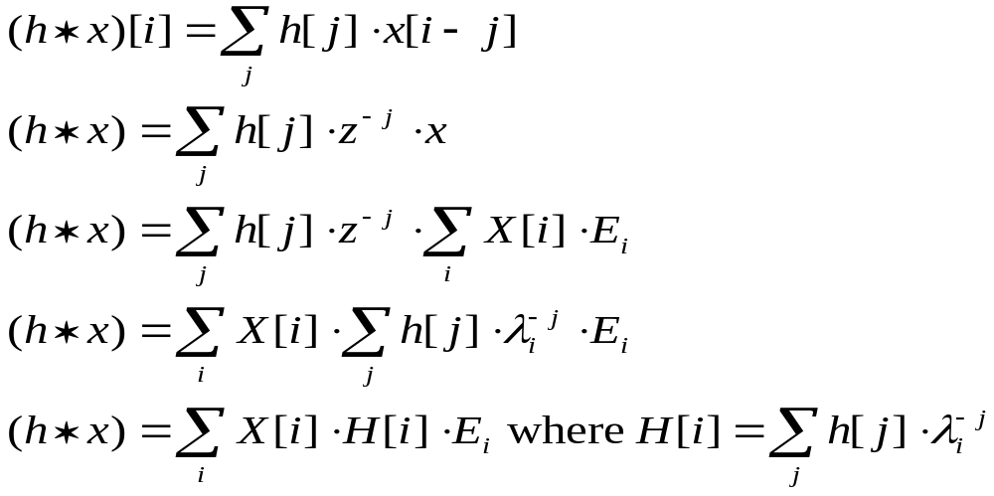
Convolution and Eigenvalues

Slide 13
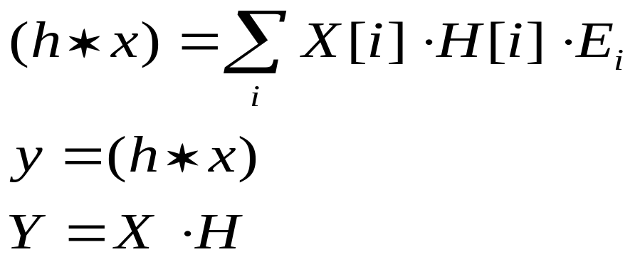
Convolution and Eigenvalues
All linear filters have the same eigenvectors
All linear filters have different eigenvalues
After transformation to a base of eigenvectors
convolution becomes multiplication

Slide 14
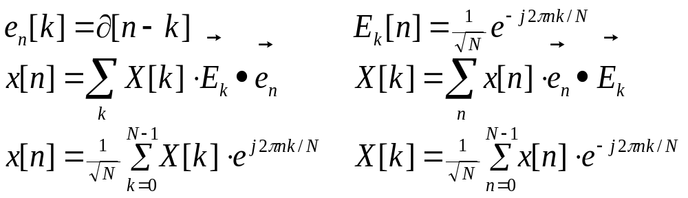
1D - Fourier Transform
Fourier Series

Slide 15
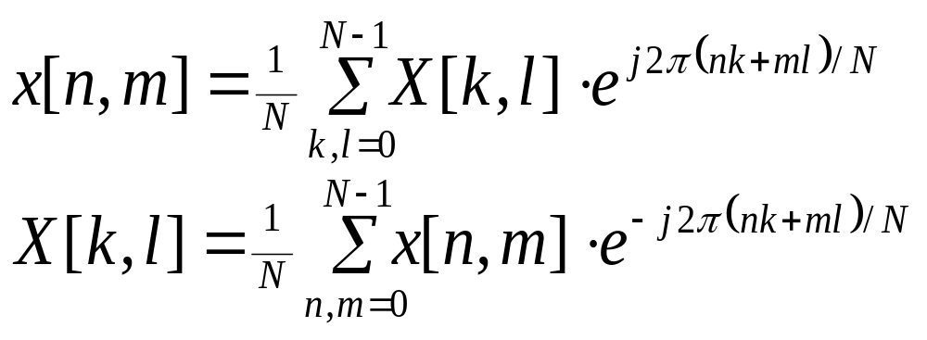
2D - Fourier Transform
Base-functions are waves

Slide 16



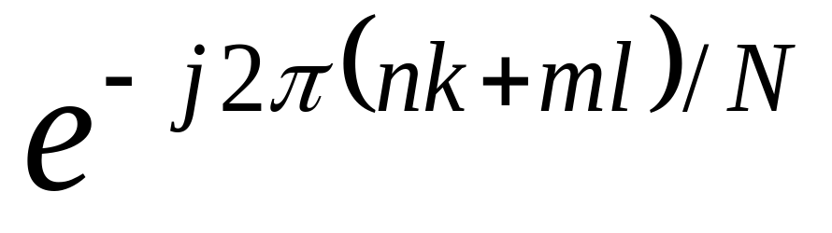






2D - Fourier Transform
k
Base-functions are waves
l

Slide 17
Other orthogonal transformations
Cosine transform
Hadamar transform
Haar transform
Wavelet transform
Karhunen-Loeve
Slant transform
cosine-functions
block-waves
hierarchical block-functions

Slide 18

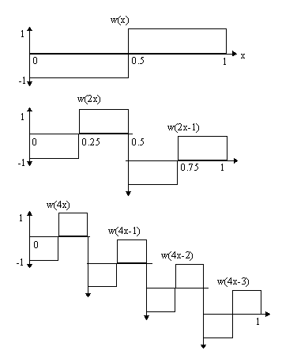
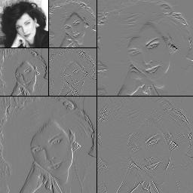
Haar Transform
Haar transform for 4x4 blocks

Slide 19
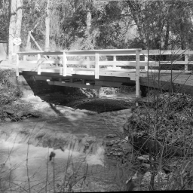
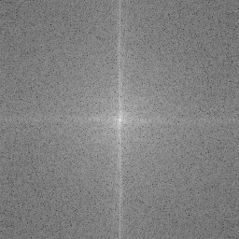
Spectrum: Bridge

Slide 20
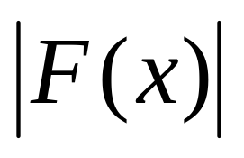
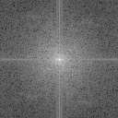

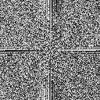
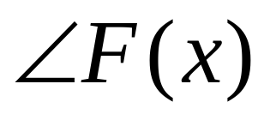
Phase and Amplitude
amplitude
phase
original

Slide 21
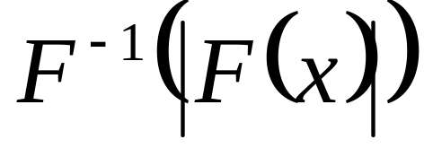
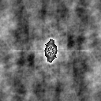
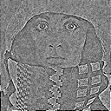
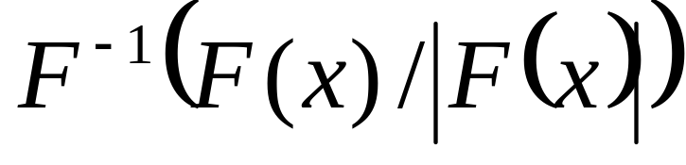
Phase and Amplitude
amplitude
phase
original

Slide 22

Periodic Images
Spectral leakage due to discontinuities
Solution: windowing

Slide 23




Spectral Window
No
Bartlett
Hamming
Hanning

Slide 24
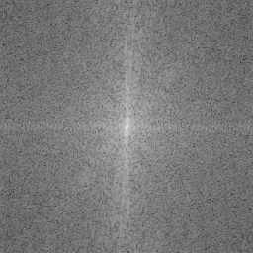
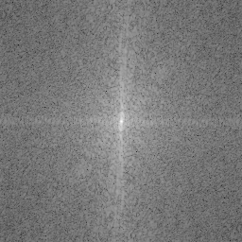
Spectral Window
No
Bartlett
Hamming
Hanning

Slide 25
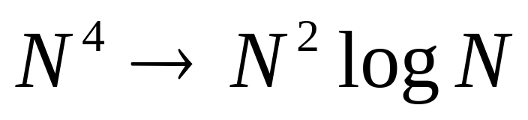
Fast Fourier transform (FFT)
recursive algorithm
decimation in time = odd even in freq. domain
decimation in freq. domain = odd even in time

Slide 26

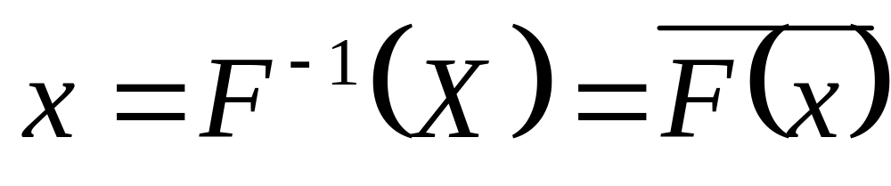
Inverse Fourier Transform

Slide 27
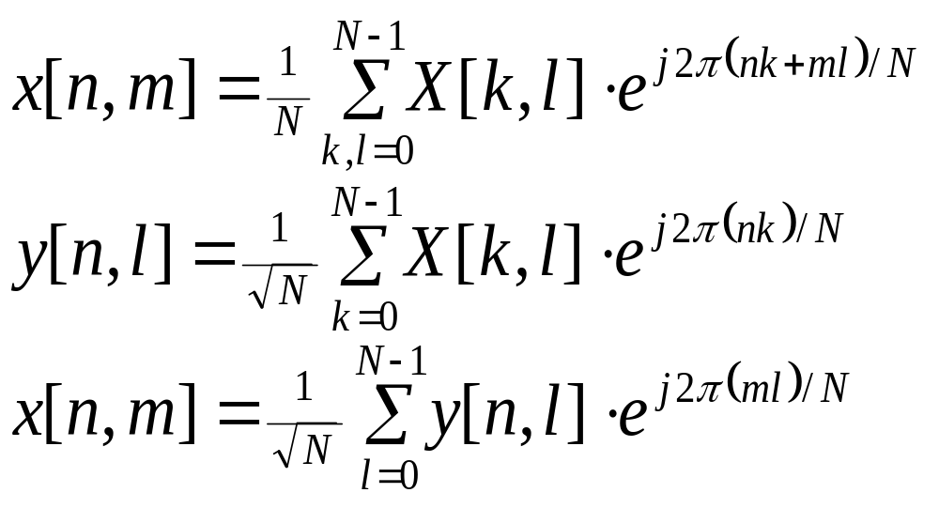
Separation
2D FFT=1D FFT for all lines and 1D FFT for all columns

Slide 28
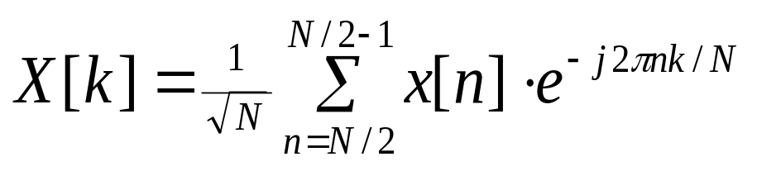
Symmetry
Time domain:
real
Hermitian
imaginairy
anti-Hermitian
even
odd
real and even
Frequency domain:
Hermitian
real
anti-Hermitian
imaginary
even
odd
real and even

Slide 29
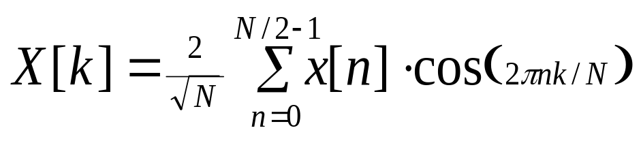
Cosine transform
“real and even” maps on “real and even”
no edge discontinuity
real spectrum
similar complexity

